Slide 1
Chicago Bike Data Observations
By: Marcus Chan

Slide 2
Objectives
More memberships will provide more long term benefits for the corporation.
How to attract more members?
How can we convert casual users to users with memberships?
Assumptions:
Total sample population 120,000 will reflect the statistics of overall whole
A sample of 10,000 are taken from each month
Data provided by is representative and doesn’t overlook critical factors
The affects of weather will not drastically change overall results apart from seasonal changes

Slide 3
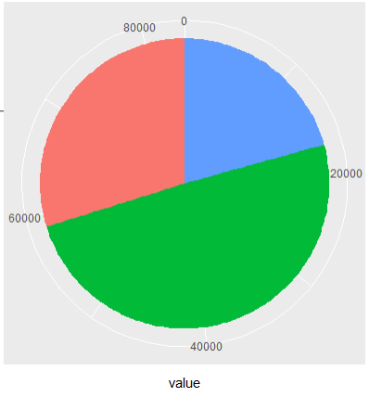
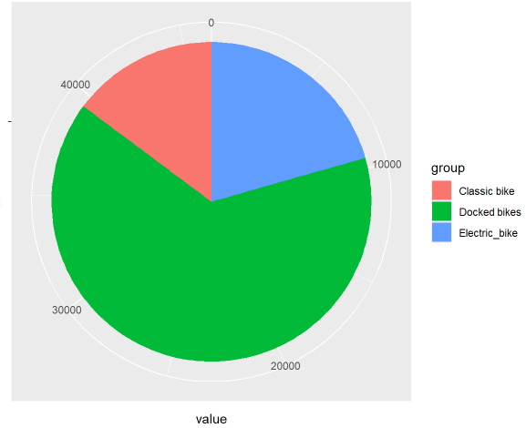
Overall Members vs Casuals Bike usage
Members
Observations:
Membership Users
prefers Docked Bikes but less than casual users
About 2/3 of the sample population
Uses electric bikes in the same ratio as casual users
Casual Users
prefers Docked Bikes
About 1/3 of the sample population
Uses Docked bikes in place of classical bikes
Casual Users

Slide 4
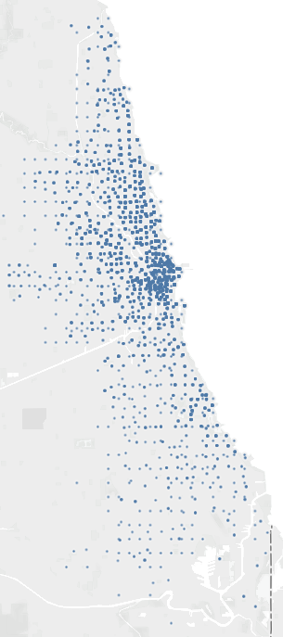
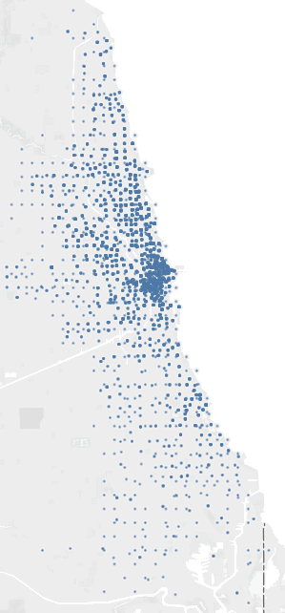
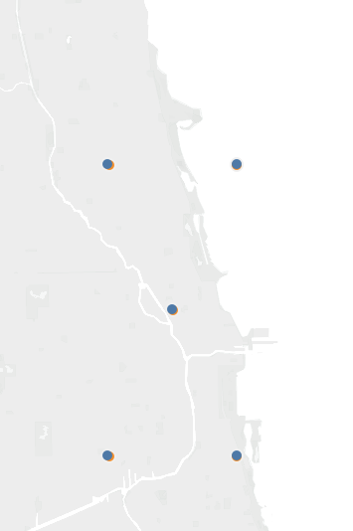
General Area of Operations: Casual Users Full Year Data
Rough area of operations
Start Destination
End Destination
Average + Standard Deviation

Slide 5
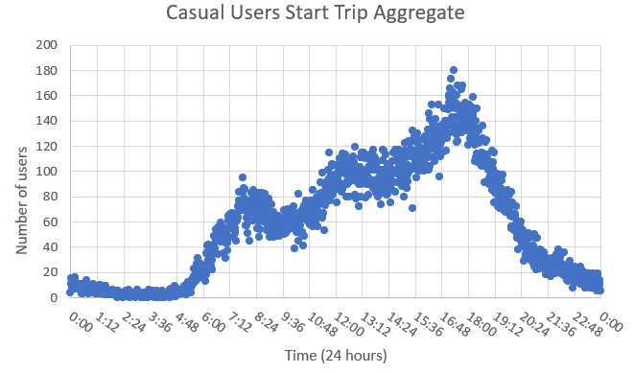
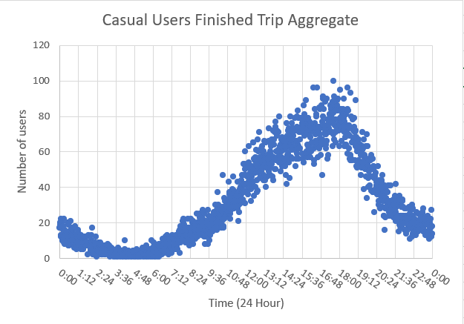
Daily Bike Usage: Casuals
Observations:
There are 3 peaks, at 7-8 am, 12-1 pm, and 5-6pm roughly
Corresponding time to:
Waking up and heading to work
Bike ride after lunch
Coming home from work
Overall increase in bike usage as day progresses perhaps due to increasing number of users free during working hours
Finished Trip Aggregate graph implies longer renting time
Notes:
The Finished Trip aggregate graph means that users are taking out bikes for longer periods of time from the bikes that were rented out but not returned from the start trip aggregate

Slide 6
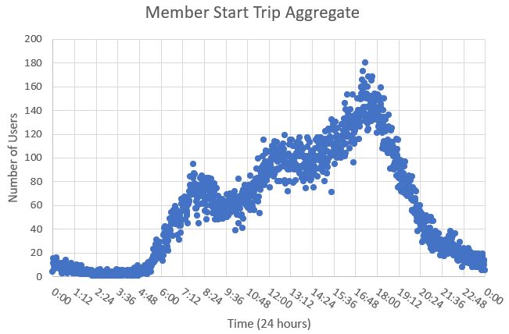
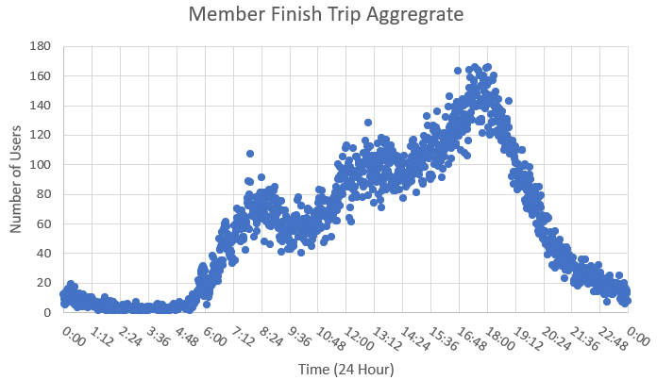
Daily Bike Usage Member
Observations:
Similar to casual users, bike activities increase as day progresses
3 peaks more defined with on both graphs
Peaks corresponding to work days
Activity drops off at drastically 8pm
Generally curve of finished trip is slightly behind start trip
Short trips for a large portion of the population

Slide 7
Recommendations
Reduce the price of memberships so it make financial sense to take a member ship rather than casually use the bikes.
We see that the casuals users have similar biking habits compared to the membership users
Increase the price of dropped bikes if the user doesn’t have a membership to encourage more people to sign up for memberships
By making targeting the largest percentage of bikes used with the exception to memberships we can selectively target a large percentage of casual users
Launch a advertising campaign around downtown Chicago about memberships to reach the most eyes using biking services.
To ensure that these changes are noticed by the most casual users we can target the area where the most traffic occurs

Slide 8
Questions?

